Slide 1
ECE 322L
Electronics 2
04/14/20 - Lecture 21
Intro to power amplifiers
Power transistors

Slide 2
Overview
Introduction to power amplifiers
Power considerations
Power transistors-BJT
Originfof current, voltage, and power rating for a transistor.
Safe operating area (SOA)
Heat transfer models from the device to the ambient.
(Neamen 6.10, 8.1, 8.2.1, 8.2.4-S&S, 6th edition, 11.7)

Slide 3
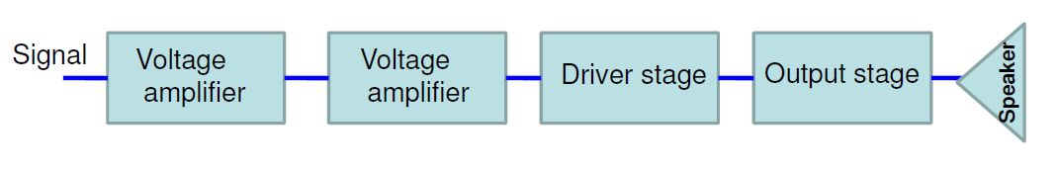
Power Amplifiers
Large-signal amplifiers
Generally the last stage of a multistage amplifier.
The function of a practical power amplifier is to deliver high power to an output device, such as a loud speaker.
Typical output power rating of a power amplifier will be 1W or higher. The schematic diagram of a multi-stage amplifier utilizing a power amplifier is shown below
Power amplifier

Slide 4
Desired functionalities of a power amplifier
Capability to deliver a high level of power to the load without loss of gain and maintaining a linear transfer function.
Limit power dissipation, i.e., efficiently deliver power to the load.
Capability to handle large voltage and current.

Slide 5
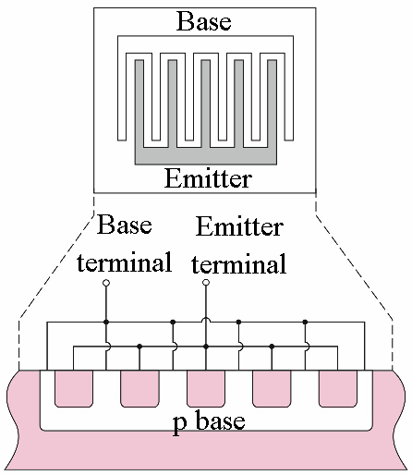
Power transistor-BJT
Power transistors are used to sustain the high output voltage and current.
Physical structure;
Large emitter area to handle large current densities
Narrow emitter width to minimize parasitic base resistance
Top view
Cross-sectional view

Slide 6
Power transistor-BJT
Large-area devices – the geometry and doping concentration are different from those of small-signal transistors
Examples of BJT rating:
Parameter | Small-signal BJT (2N2222A) | Power BJT (2N3055) | Power BJT (2N6078)
V_{CE} (max) (V) | 40 | 60 | 250
I_{C} (max) (A) | 0.8 | 15 | 7
P_{D} (max) (W) | 1.2 | 115 | 45
β | 35 – 100 | 5 – 20 | 12 – 70
f_{T} (MHz) | 300 | 0.8 | 1

Slide 7
Transistor rating
Power transistors need to withstand high levels of voltage, current, and power. Hence, it is important to understand what determines transistors ratings.
A transistor is characterized by three limitations
Maximum rated current
Maximum rated voltage
Maximum rated power.
These three limitations define a safe operating area (SOA) for a transistor

Slide 8
Current rating
The maximum rated collector current, I_{C(rated)} may be related to the following:
maximum current that the wires connecting the semiconductor to the external terminals can handle
current which leads to maximum power dissipation when the transistor is in active mode.
the collector current at which the gain falls below a minimum specified value

Slide 9
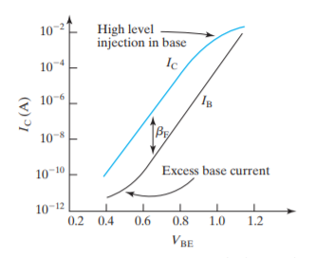
Current rating
Current gain vs I_{c}

Slide 10
Voltage rating
The maximum (output) voltage limitation is determined by the onset of breakdown.
Breakdown is a deleterious effect that occurs in the presence of high electric field.
Causes high resistance elements to allow flow of high current.
Typically an irreversible effect permanently damaging the element.

Slide 11
Avalanche Breakdown
Two types of breakdown occur in BJTs
Avalanche breakdown in the reverse-biased base-collector junction (involves gain and breakdown at the p-n junction)
Second breakdown – non-uniformities in current density which increase temperature in localized regions of the semiconductor.

Slide 12
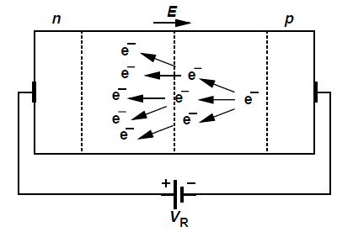
Avalanche Breakdown
In reverse biased junctions a wide depletion region causes high electric field and tremendous acceleration.
Very few electrons make it through depletion region with high velocity.
These electrons collide with atoms in the depletion region and free more electrons (Process called Multiplication).
Results in higher and higher current flow which cause permanent damage to the device.

Slide 13
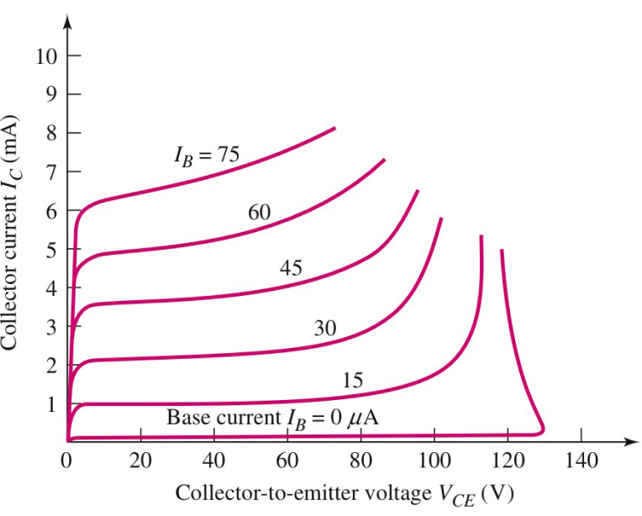
Avalanche (Primary) Breakdown
In a BJT in forward active mode the B-C junction is reverse biased. In an npn, as the VCE increases, the voltage on the collector becomes significantly higher than the voltage on the base.
A point is reached where avalanche occurs at the B-C junction.
Thus the collector current dramatically increases.
The breakdown voltage when the base terminal is open-circuited (I_{B}=0) is V_{CEO}, approx. 130V
All the curves tend to merge to the same collector-emitter voltage, denoted as V_{CE(sus)} once breakdown has occurred.
V_{CE(sus)} is the voltage necessary to sustain the transistor in breakdown.

Slide 14
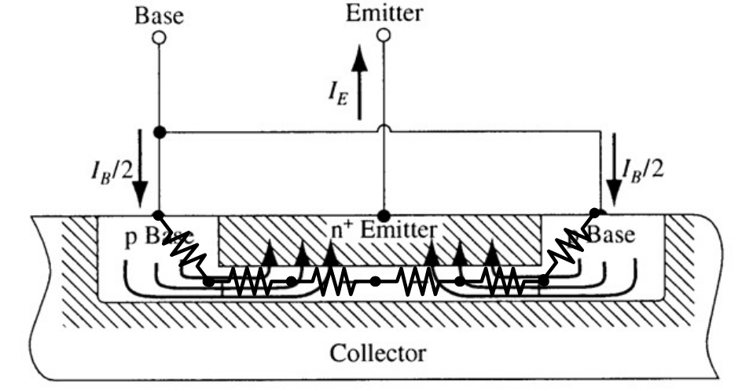
Second-breakdown
Second-Breakdown occurs because current flow across the emitter–base junction is not uniform. Rather, the current density is greatest near the periphery of the junction (current crowding).

Slide 15
Second-Breakdown
Locally dissipated power and hence temperature rise (at locations called hot spots).
Since a temperature rise causes an increase in current, a localized form of thermal runaway can occur, leading to junction destruction.
Thermal Runaway: Increase in temperature leads to higher current and power dissipation, which in turn increases the temperature further until the device is destroyed.

Slide 16
Dissipate power in a BJT
The average power dissipated in a BJT must be kept below a specified maximum value to ensure that the temperature of the device does not exceed the maximum allowable value.
The maximum rated power, P_{T}
The power handling ability of a BJT is limited by two factors, i.e. the maximum junction temperature, T_{Jmax} that the BJT can be operated at and second-breakdown.

Slide 17
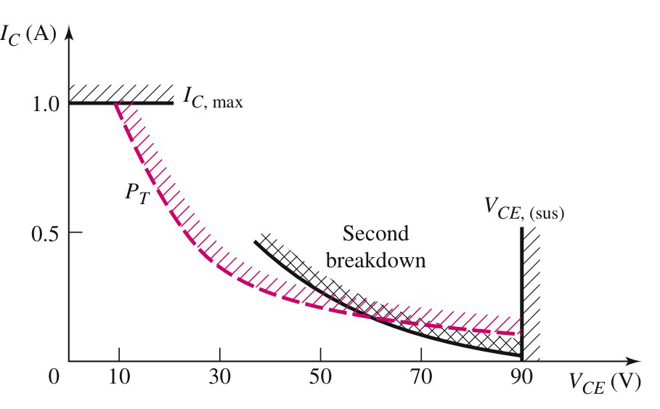
Safe operating area (SOA)
The safe operating area (SOA) is bounded by I_{C(max)}; V_{CE(sus)} and maximum rated power curve, P_{T} and the transistor’s second breakdown characteristics curve.
SOA of a BJT (linear scale)
The load lines must be within the SOA

Slide 18
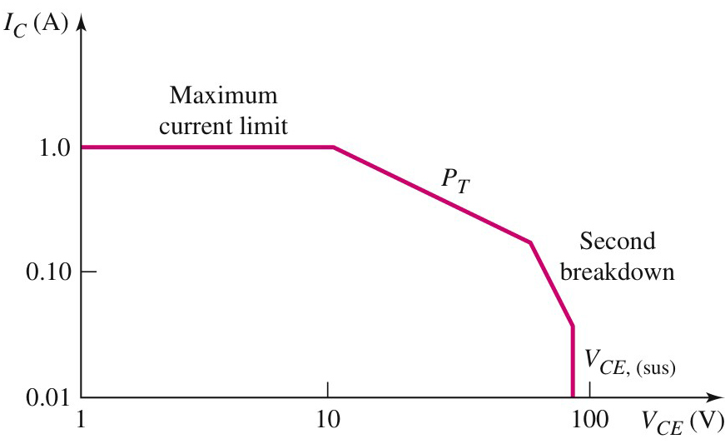
Safe operating area (SOA)
SOA of a BJT (log scale)

Slide 19
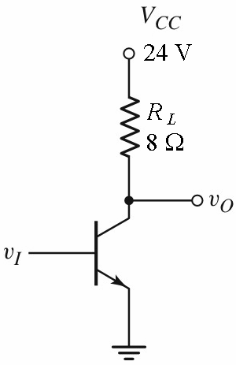
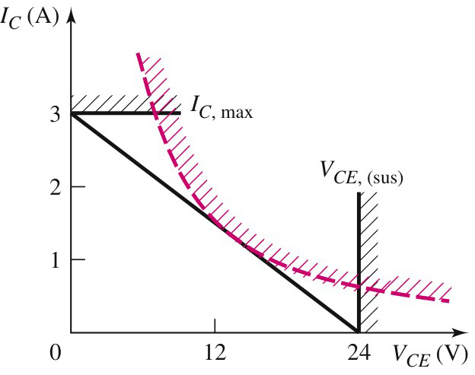
In-class problem 1
Determine the required DC ratings (current, voltage and power) of the BJT.

Slide 20
In-class problem 1, solution
For the maximum collector current;
For the maximum collector-emitter voltage;

Slide 21
In-class problem 1, solution
The maximum power occurs when
i.e. when
Differentiating
or when
At this point;
and;

Slide 22
In-class problem 1, solution
Thus the transistor ratings are;
In practice, to find a suitable transistor for a given application, safety factors are normally used. A
transistor with will be required.

Slide 23
In-class problem 1, solution
The load line equation is;
The load line must be within the SOA

Slide 24
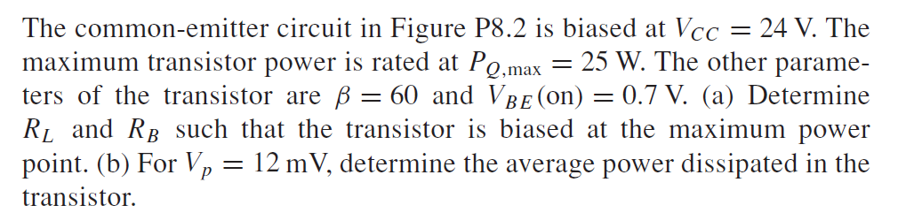
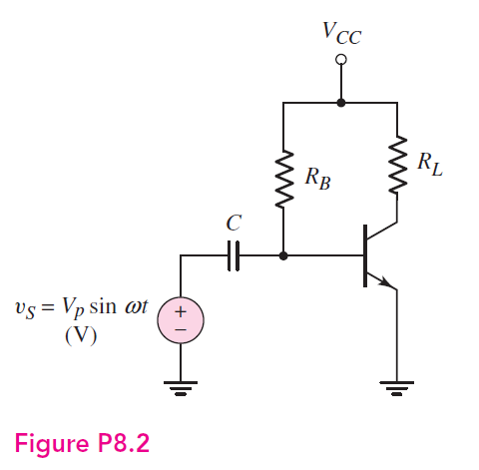
Take-home problem 1

Slide 25
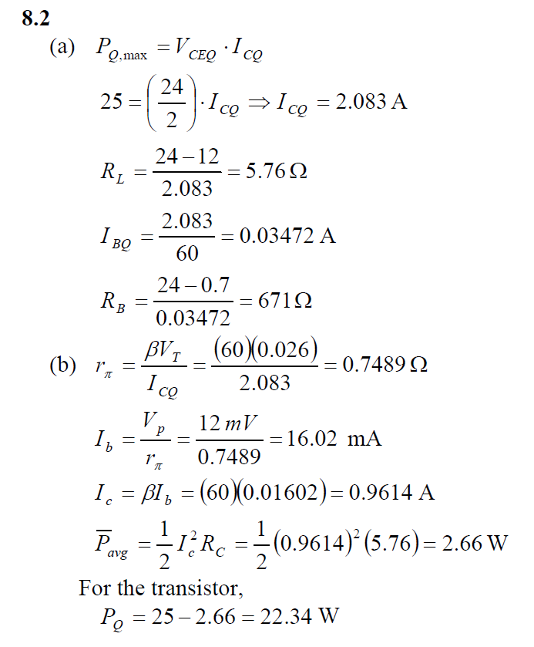
Take-home problem 1, solution

Slide 26

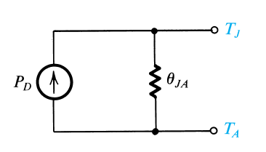
Heat Flow From Device to Ambient
Power transistors dissipate large amounts of power.
The dissipated power is converted into heat, which raises the junction temperature. However, the junction temperature T_{J} must not be allowed to exceed a specified maximum, T_{Jmax}; otherwise the transistor could suffer permanent damage.
In a steady state in which the transistor is dissipating P_{D} watts, the temperature rise of
the junction relative to the surrounding ambience can be expressed as
θ_{jA}: Thermal resistance between the junction and the ambient.

Slide 27
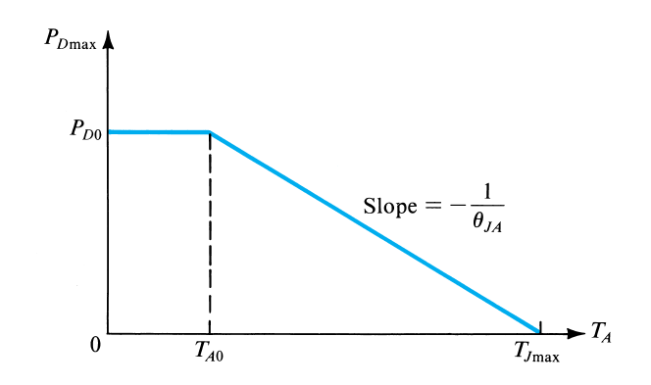
Power Derating Curve
Maximum allowable power dissipation versus ambient temperature for a
BJT operated in free air. This is known as a “power-derating” curve.
A
jA

Slide 28




Heat Sink
θ_{jA}: Thermal resistance between the junction and the ambient.
θ_{jC} :Thermal resistance between the junction and the case.
θ_{CS} : Thermal resistance between the case and the heat sink.
θ_{SA} : Thermal resistance between the heat sink and the ambient.
A low thermal resistance is
desired to efficiently remove heat from the junction, thereby increasing the power rating of the transistor

Slide 29
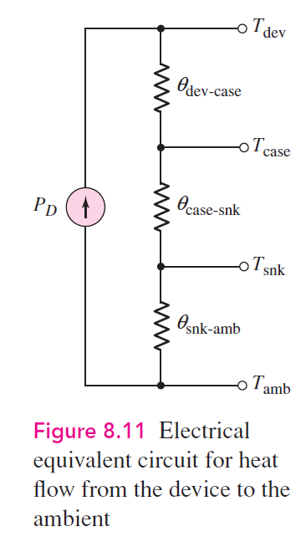
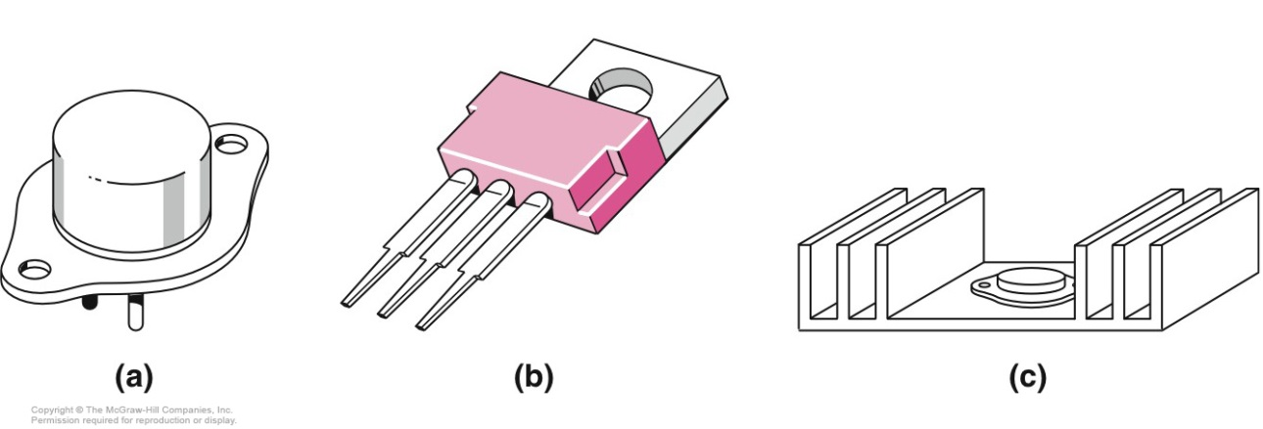
Heat Sinks
Without heat sink
With heat sink

Slide 30
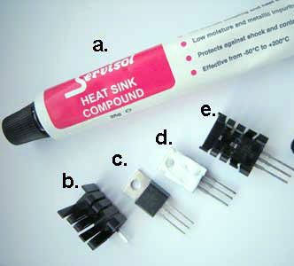
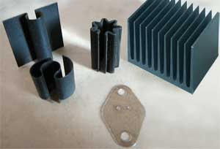
Heat Sinks
Examples of heat sinks
(a) Tube of heat-sink compound.
(b) Heat-sink.
(c) TIP31 transistor.
(d) shows the transistor smeared with heat-sink compound.
(e) shows the transistor fitted to the heat-sink.

Slide 31
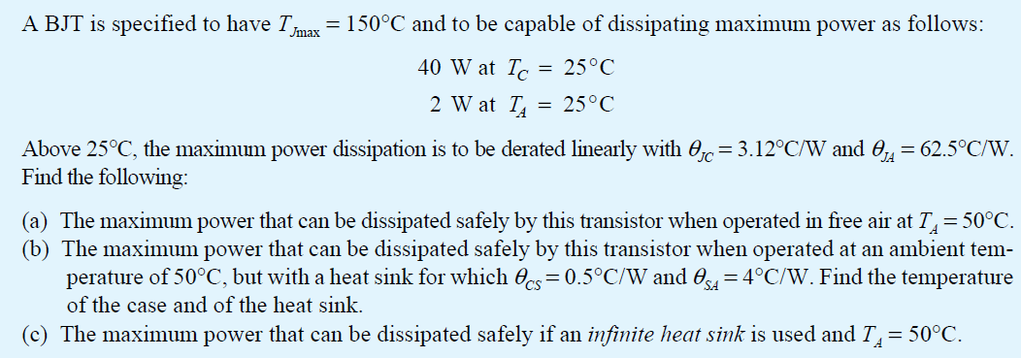
In-class problem 2

Slide 32
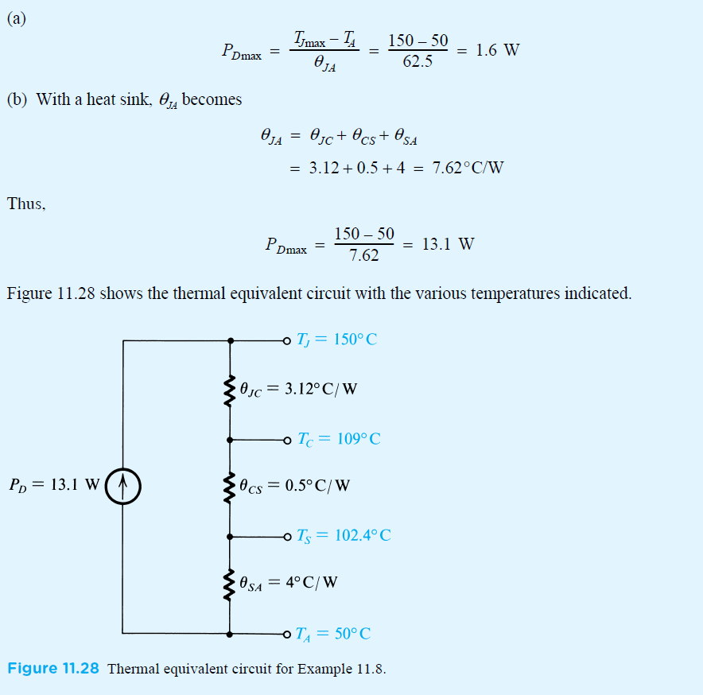
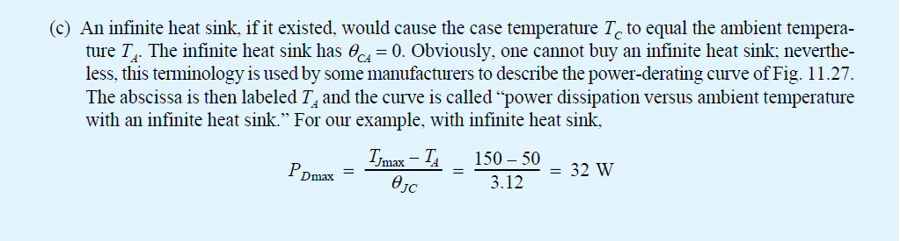
In-class problem 2, solution

Slide 33
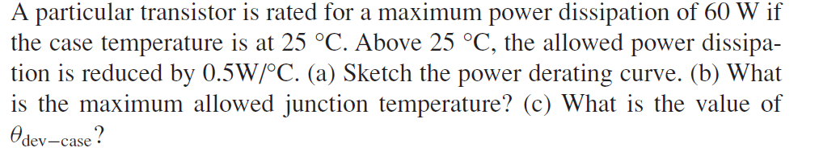
Take-home problem 2

Slide 34
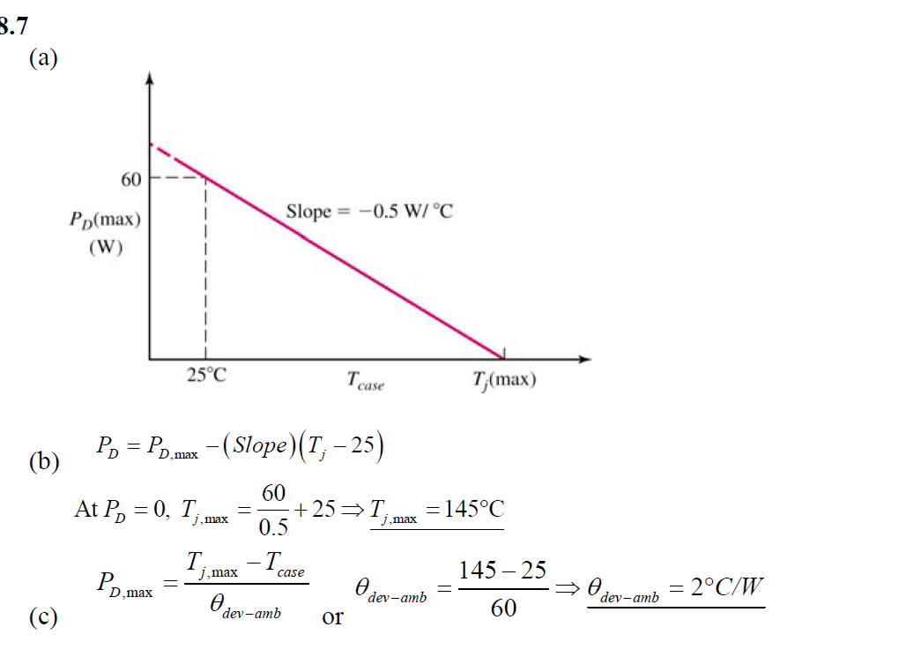
Take-home problem 2, solution

